Slide 1


A Constructive Approach
to Incremental Learning
Mario R. GUARRACINO
National Research Council, Naples, Italy

Slide 2
Classification of pain relievers
Naproxen
– Ineffective
+ Effective
–
–
?
–
–
–
–
–
–
?
–
–
–
–
B
–
B
A
–
+
A
–
–
+
+
+
+
+
+
+
?
+
+
+
+
+
+
Sodium

Slide 3
Introduction
Supervised learning refers to the capability of a system to learn from examples
Such systems take as input a collection of cases
  each belonging to one of a small number of classes, and
  described by its values for a fixed set of attributes,
  and output a classifier that can accurately predict the class to which a new case belongs
Supervised means the class labels for the input cases are provided by an external teacher

Slide 4
Introduction
Classification has become an important research topic for theoretical and applied studies
Extracting information and knowledge from large amount of data is important to understand the underlying phenomena
Binary classification is among the most successful methods for supervised learning

Slide 5
Applications
Detection of gene networks discriminating tissues that are prone to cancer
Identification of new genes or isoforms of gene expressions in large datasets
Prediction of protein-protein and small molecules-protein interactions
Reduction of data spatiality and principal characteristics for drug design

Slide 6
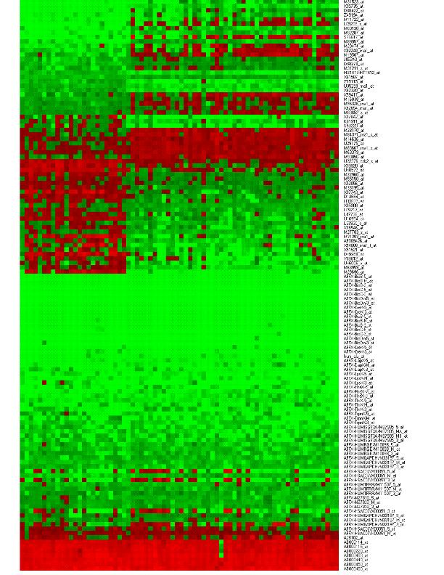
Motivation
Data produced in experiments will exponentially increase over the years
In genomic/proteomic experiments, data are often updated, which poses problems to the training step
Datasets contain gene expression data with tens of thousands characteristics
Current methods can over-fit the problem, providing models that do not generalize well

Slide 7
Linear discriminant planes
Consider a binary classification task with points in two linearly separable sets.
  There exists a plane that classifies all points in the two sets
There are infinitely many planes that correctly classify the training data.
–
–
–
–
–
–
–
–
–
–
–
–
B
–
B
A
–
+
A
–
–
+
+
+
+
+
+
+
+
+
+
+
+
+

Slide 8
Support Vector Machines
State of the art machine learning algorithm
||
ω
||
2
–
–
min
–
–
–
–
ω
≠
0
2
–
–
–
–
–
–
–
B
–
+
B
A
–
+
s
.
t
.
A
ω
+
γ
≥
e
A
–
–
+
+
+
ω
+
<
−
B
γ
e
+
+
+
+
+
+
+
+
+
+
+
The main idea is to find the plane x’ω – γ = 0 which maximizes the margin between the two classes

Slide 9
SVM classification
Their robustness relies in the strong fundamentals of statistical learning theory
The training relies on optimization of a quadratic convex cost function, for which many methods are available
  Available software includes SVM-Lite and LIBSVM
These techniques can be extended to the nonlinear discrimination, embedding the data in a nonlinear space using kernel functions

Slide 10
A different religion: ReGEC
A binary classification problem can be formulated as a generalized eigenvalue problem
  Find x’ω – γ = 0 closest to A and the farthest from B:
–
||
A
ω
−
e
γ
||
2
–
–
–
min
–
ω,
γ
≠
0
||
B
ω
−
e
γ
||
2
–
–
–
–
–
–
–
B
–
+
B
A
–
?
+
A
–
–
+
+
+
+
+
+
+
+
+
+
+
+
+
M.R. Guarracino, C. Cifarelli, O. Seref, P. Pardalos. A Classification Method Based on Generalized Eigenvalue Problems, OMS, 2007

Slide 11
ReGEC algorithm
||
A
ω
−
e
γ
||
2
min
ω,
γ
≠
0
||
B
ω
−
e
γ
||
2
Let:
Previous equation becomes:
Raleigh quotient of generalized eigenvalue problem
Gx = λ Hx
G
=
[
A
−
e
]
T
[
A
−
e
],
H
=
[
B
−
e
]
T
[
B
−
e
],
z
=
[
ω
′
γ
]'.
z
′
Gz
min
z
∈
R
n
+
1
z
′
Hz

Slide 12
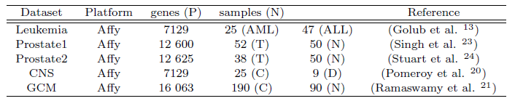
Classification accuracy (%)
⁽¹⁾ 10-fold ⁽²⁾ LOO
Dataset | Null | ReGEC ⁽¹⁾ | SVM⁽²⁾
Leukemia | 65.27 | 98.33 | 98.61
Prostate1 | 50.98 | 84.62 | 91.18
Prostate2 | 56.81 | 65.78 | 76.14
CNS | 73.52 | 65.78 | 82.35
GCM | 67.85 | 70.45 | 93.21
SVM
–
–
–
–
–
–
–
–
–
–
–
–
–
B
A
–
–
+
+
B
A
–
–
+
+
+
+
+
+
+
+
+
+
+
+
+
+
ReGEC
–
–
–
–
–
–
–
–
–
–
–
–
B
A
–
–
+
B
A
–
–
+
+
+
+
+
+
+
+
+
+
+
+
+

Slide 13
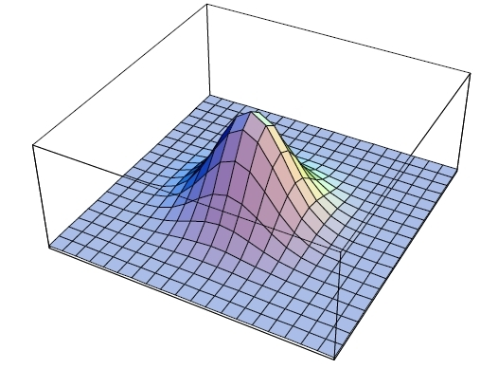
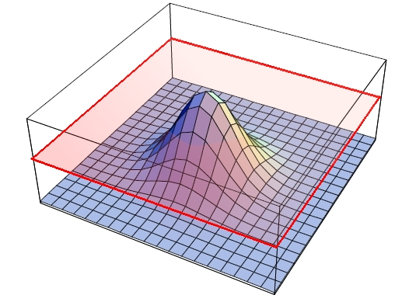
The kernel trick
–
–
–
+
+
–
+
+
+
–
–
–
–
When cases are not linearly separable, embed points into a nonlinear space
Kernel functions, like the RBF kernel :
Each element of kernel matrix is:
||
x
−
x
||
2
−
i
j
K
(
x
,
x
)
=
e
σ
i
j
||
A
−
Γ
||
2
–
–
–
−
i
j
K
(
A
,
Γ
)
=
e
σ
+
+
–
+
ij
+
+
–
–
–
–

Slide 14
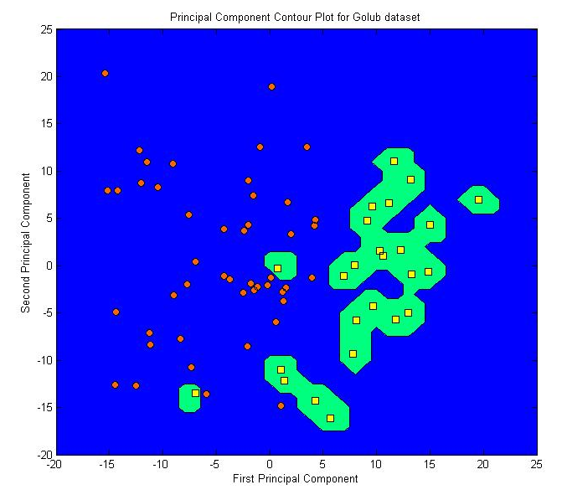
Generalization of the method
In case of noisy data, surfaces can be very tangled
Course of dimesionality
affects results
Those models fit training cases, but do not generalize well to new cases (over-fitting)

Slide 15
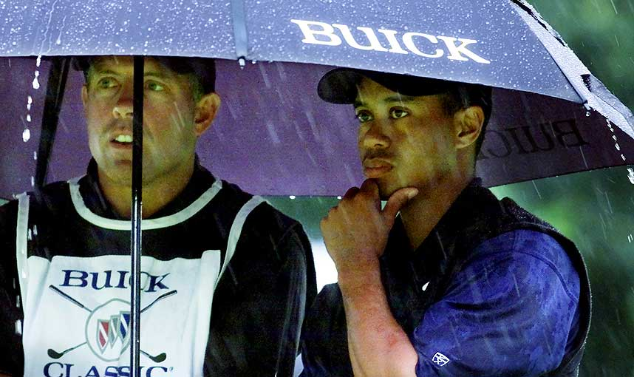
How to solve the problem?

Slide 16
Incremental classification
A possible solution is to find a small and robust subset of the training set that provides comparable accuracy results
A smaller set of cases reduces the probability of over-fitting the problem
A kernel built from a smaller subset is computationally more efficient in predicting new class labels, compared to kernels that use the entire training set
As new points become available, the cost of retraining the algorithm decreases, if the influence of the new cases is only evaluated by the small subset
C. Cifarelli, M.R. Guarracino, O. Seref, S. Cuciniello, and P.M. Pardalos. Incremental Classification with Generalized Eigenvalues, JoC, 2007.

Slide 17
I-ReGEC: Incremental ReGEC
1: Γ₀ = C \ C₀
2: {M₀, Acc₀} = Classify( C; C₀ )
3: k = 1
4: while | M_{k-1} ∩ Γ_{k-1} | > 0 do
5: x_{k} = x : max_{x ∈ {Mk-1 ∩ Γk-1}} {dist(x, P_{class(x)})}
6: {M_{k}, Acc_{k} } = Classify( C; {C_{k-1} U {x_{k}}} )
7: if Acc_{k} > Acc_{k-1} then
8: C_{k} = C_{k-1} U {x_{k}}
9: end if
10: k = k + 1
11: Γ_{k} = Γ_{k-1} \ {x_{k}}
12: end while
∈

Slide 18
I-ReGEC: Incremental ReGEC
ReGEC accuracy=84.44 I-ReGEC accuracy=85.49
When ReGEC algorithm is trained on all training cases, surfaces are affected by noisy cases (left)
I-ReGEC achieves clearly defined boundaries, preserving accuracy (right)
  Less then 5% of points needed for training!

Slide 19
Classification accuracy (%)
⁽¹⁾ 10-fold ⁽²⁾ LOO
Dataset | Null | ReGEC ⁽¹⁾ | IReGEC ⁽¹⁾ | SVM⁽²⁾
Leukemia | 65.27 | 98.33 | 100 | 98.61
Prostate1 | 50.98 | 84.62 | 82.35 | 91.18
Prostate2 | 56.81 | 65.78 | 65.91 | 76.14
CNS | 73.52 | 65.78 | 73.41 | 82.35
GCM | 67.85 | 70.45 | 100 | 93.21

Slide 20
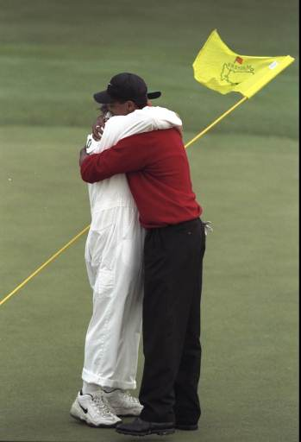
Positive results
Incremental learning, in conjunction with ReGEC, reduces training sets dimension
Accuracy results do not deteriorate selecting fewer training cases
Classification surfaces can be generalized

Slide 21
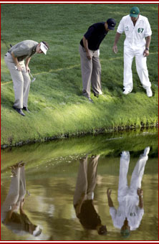
Ongoing research
It is possible to integrate
prior knowledge in a
classification model?
A natural approach would be to plug such knowledge in a classifier adding more cases during training
  This results in higher computational complexity, and in a tendency to over-fitting
Different strategies need to be devised to take advantage of prior knowledge

Slide 22
Prior knowledge
An interesting approach is to analytically express knowledge as additional constraints to the optimization problem defining a standard SVM
This solution has the advantage
  not to increase the dimension of the training set,
  to avoid over-fitting and poor generalization of the classification model
An analytical expression of knowledge is needed

Slide 23
Prior knowledge incorporation
−
+
h₁(x) ≤ 0
+
+
+
−
+
−
+
g(x) ≥ 0
+
−
+
−
K(x’, Γ^{T})u = γ
−
−
−

Slide 24
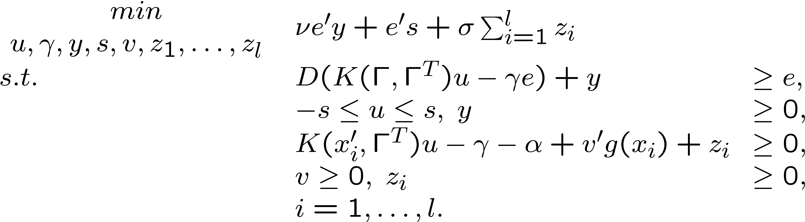
Prior knowledge in SVM
Maximize the margin between the two classes, constraining the classification model to leave one positive region in the corresponding halfspace:
Simple extension to multiple knowledge regions
O. Mangasarian, E. Wild Nonlinear Knowledge-Based Classification. IEEE TNN, 2008.

Slide 25
Prior knowledge in ReGEC
It is possible to extend this approach to ReGEC
The idea of increasing the information contained in the training set with additional knowledge is appealing for biomedical data
The experience of field experts or previous results can be readily transferred to new problems

Slide 26
Prior knowledge in ReGEC
Let Δ be the set of points in B describing a priori knowledge, constraint matrix C represents knowledge imposed on class B:
Constraint imposes all points in Δ to have zero distance from the plane => to belong to B
–
–
–
–
K
(
x
'
,
Γ
)
u
−
γ
=
0
–
–
1
1
–
–
–
–
–
–
–
x
∈
Δ
⇒
C
T
z
=
0
–
–
+
–
–
+
+
+
+
K
(
x
'
,
Γ
)
u
−
γ
=
0
2
2
+
+
+
+
+
+
+
+
+
+
+

Slide 27
Prior knowledge in ReGEC
Prior knowledge can be expressed in terms of orthogonality of the solution to a chosen subspace:
where C is a n × p matrix of rank r, with r < p < n
The constrained eigenvalue problem with prior knowledge for points in class B is:
C
T
z
=
0
z
'
G
z
min
,
z
≠
0
z
'
H
z
s
.
t
.
C
T
z
=
0

Slide 28
Knowledge discovery for ReGEC
We propose a method to discover knowledge in the training data, using a learning method consistently different from SVM
Logic mining method Lsquare, combined with a feature selection based on integer programming, is used to extract logic formulas from the data
The most meaningful portions of such formulas represent prior knowledge for ReGEC

Slide 29
Knowledge discovery for ReGEC
Results exhibit an increase in the recognition capability of the system
We propose a combination of two very different learning methods:
  ReGEC, that operates in a multidimensional Euclidean space, with highly nonlinear data transformation, and
  Logic Learning, that operates in a discretized space with models based on propositional logic
The former constitutes the master learning algorithm, while the latter provides the additional knowledge
G. Felici, P. Bertolazzi, M. R. Guarracino, A. Chinchuluun, P. Pardalos. Logic formulas based knowledge discovery and its application to the classification of biological data. BIOMAT 2008.

Slide 30
Logic formulas
The additional knowledge for ReGEC is extracted from training data with a logic mining technique
Such choice is motivated by two main considerations:
  the nature of the method is intrinsically different from the SVM adopted as primary classifier;
  the logic formulas are, semantically, the form of ``knowledge" closest to human reasoning and therefore resemble at best contextual information.
The logic mining system consists of two main components, each characterized by the use of integer programming models

Slide 31
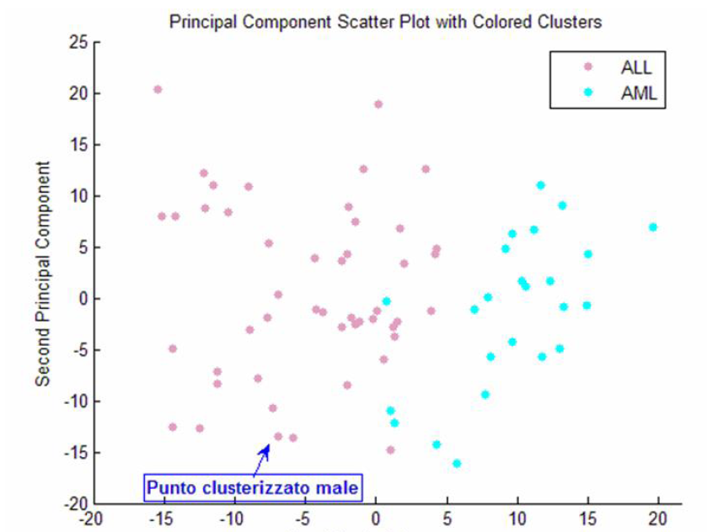
Acute Leukemia data
Golub microarray dataset (Science, 1999)
The microarray data have 72 samples with 7129 gene expression values
Data contain 25 Acute Myeloid Leukemia and 47 Acute Lymphoblastic Leukemia samples

Slide 32
Logic formulas
The dataset has been discretized and the logic formulas have been evaluated. Those formulas are in the form:
    IF p(4196) > 3.435 AND p(6041) > 3.004 THEN class1,
    IF p(6573) < 2.059 AND p(6685) > 2.794 THEN class1,
    IF p(1144) > 2.385 AND p(4373) < 3.190 THEN class − 1,
    IF p(4847) < 3.006 AND p(6376) < 2.492 THEN class − 1,
where p(i) represents the i-th probe.
The knowledge region for each class, are those given by the intersection of all chosen formulas.

Slide 33
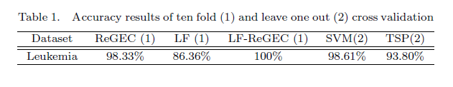
Classification accuracy
The LF-ReGEC method is fully accurate on the dataset.

Slide 34
Classification accuracy (%)
⁽¹⁾ LOO ⁽²⁾ 10-fold
Dataset | Null | ReGEC ⁽¹⁾ | IReGEC ⁽¹⁾ | LF-ReGEC ⁽¹⁾ | LF⁽¹⁾ | SVM⁽²⁾
Leukemia | 65.27 | 98.33 | 100 | 100 | 86.36 | 98.61
Prostate1 | 50.98 | 84.62 | 82.35 | 84.62 | 77.80 | 91.18
Prostate2 | 56.81 | 65.78 | 65.91 | 75.25 | 73.50 | 76.14
CNS | 73.52 | 65.78 | 73.41 | 82.58 | 79.20 | 82.35
GCM | 67.85 | 70.45 | 100 | 71.43 | 79.60 | 93.21

Slide 35
Acknowledgements
ICAR-CNR
  Salvatore Cuciniello
  Davide Feminiano
  Gerardo Toraldo
  Lidia Rivoli
IASI-CNR
  Giovanni Felici
  Paola Bertolazzi
UoF
  Panos Pardalos
  Claudio Cifarelli
  Onur Seref
  Altannar Chinchuluun
SUN
  Rosanna Verde
  Antonio Irpino

