Slide 1

classification of gene expression data
Mario.Guarracino@cnr.it

Slide 2
Outline
Microarrays: when, what, why, how, …
Classification: SVM, ReGEC, RBF NN
A priori knowledge in classification models
Knowledge as a mining task
A case study
Conclusions

Slide 3
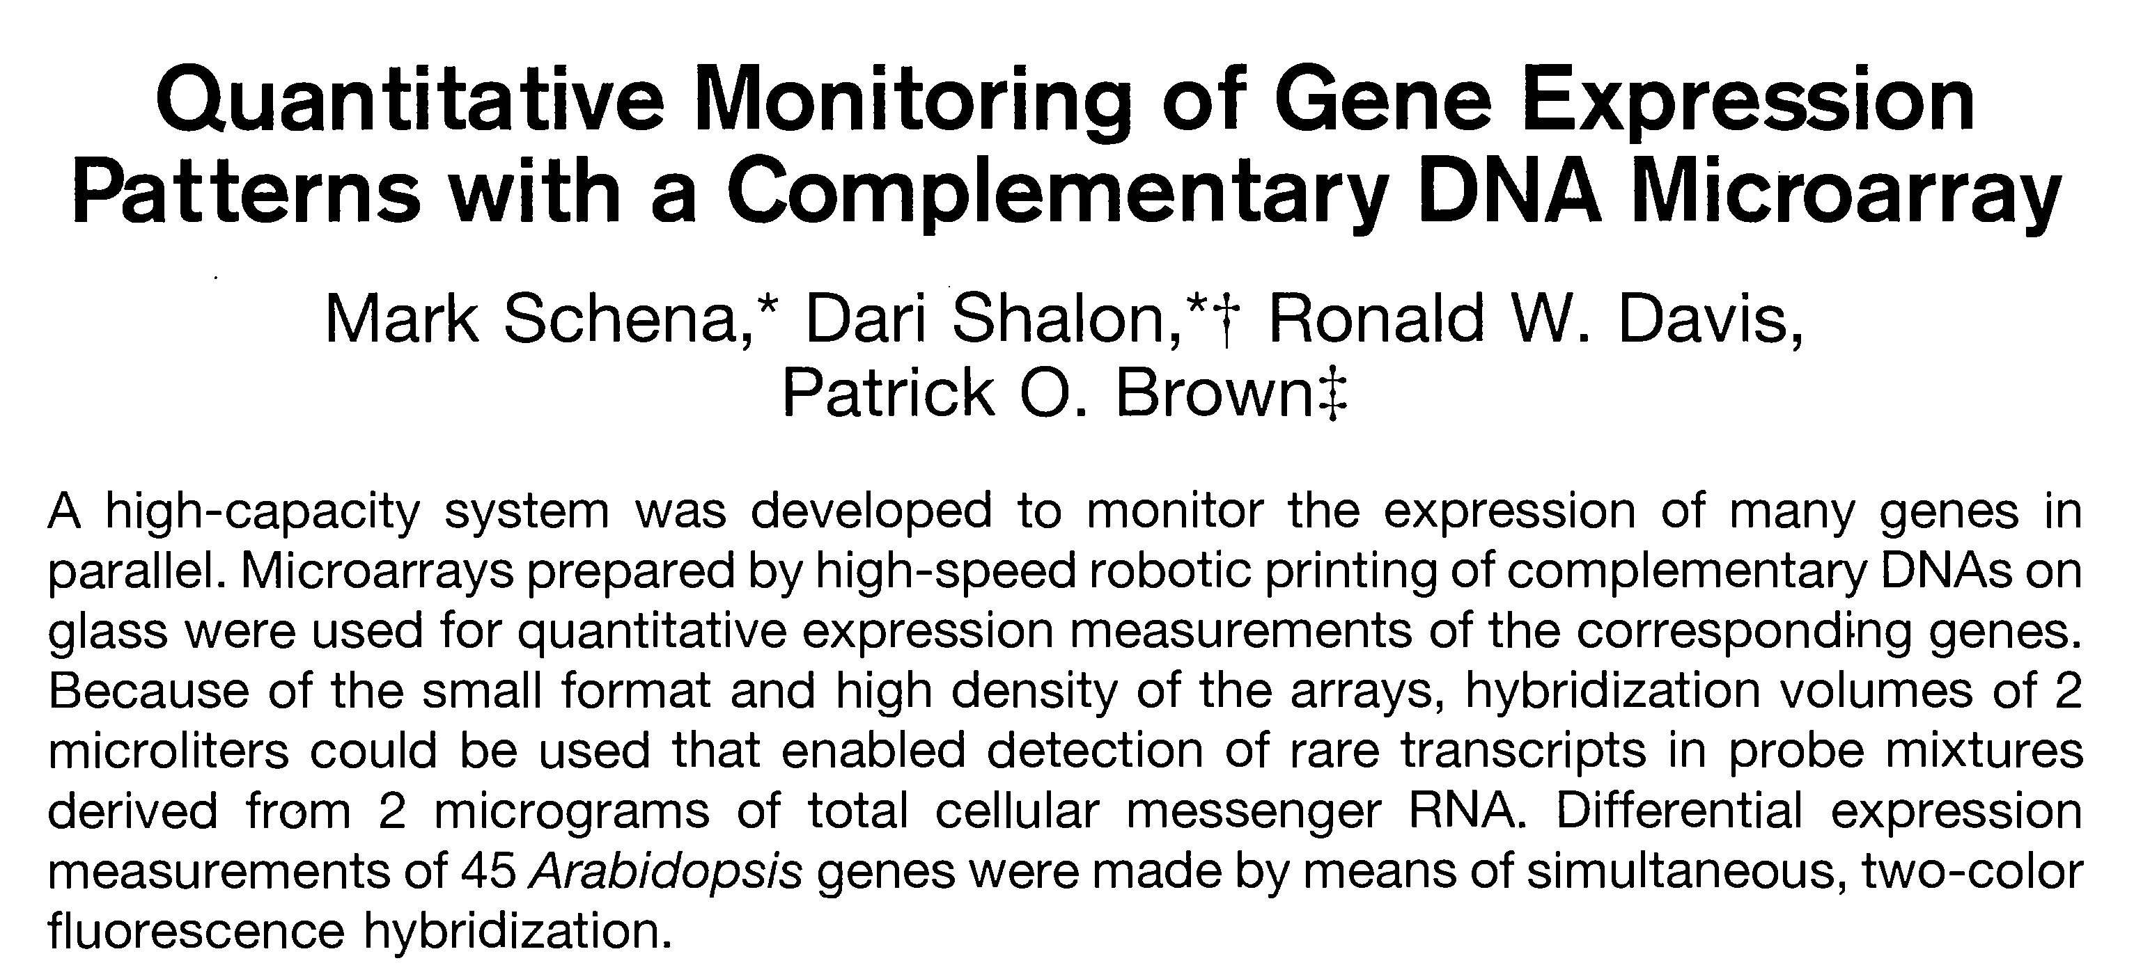
When did it all begin?

Slide 4
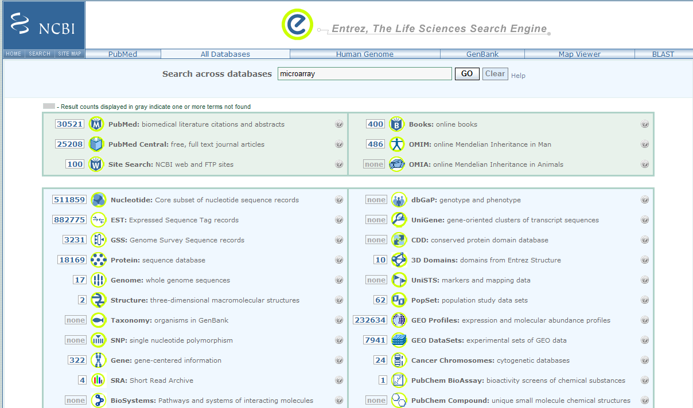
Where are we now?!
About 30k hits for
microarray in Pubmed

Slide 5
Gene expression process
The genetic information of an organism is stored in a string composed of 4 letters (nucleotides).
These strings form the DNA molecules that compose the genome of an organism.
The genome contains segments of DNA that encode genes.
Genes are transcribed in messenger RNA and translated to form proteins.

Slide 6
Gene expression process
mRNA
Translation
DNA
Transcription
Protein
Modification
and folding
Regulation of
gene expression
Cell structure
Replication
Protein
function
Protein
structure
Repair
…
Metabolism

Slide 7
Microarrays
DNA is present in nearly all cells of an organism, but these are not all the same.
Many differences are due to the different subset of genes that are expressed in the different cell types.
Microarrays permit the detection of abundance of various mRNA molecules in a cell.
The abundance of each mRNA can provide information on the corresponding protein.

Slide 8
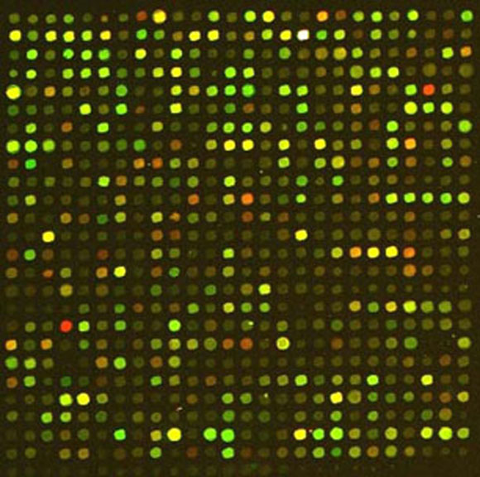
How do microarrays work?
DNA microarrays are typically glass slides on which is printed a series of spots (tens of thousands) of DNA.
Each spot corresponds to some portion of a known gene or predicted open reading frame.
Each spot should identify the expression level of mRNA transcript by a gene.

Slide 9

From images to data
The raw data are digital images.
To obtain information about expression levels, each spot is identified and its intensity measured.
Raw data
Spot matrices
Gene expression
data matrix

Slide 10
Missing and noisy data
In the process of extracting one intensity level from each spot, many values are missing or affected by an error.
Solutions adopted: ignore sample, estimate or impute a value.
Due to the cost of each experiment, missing values are estimated.

Slide 11
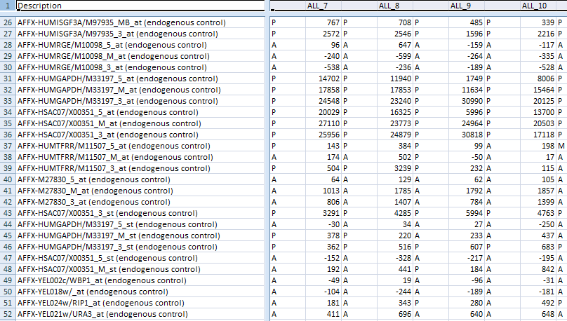
An example of data file
P = Present
A = Absent

Slide 12
Microarray applications
Gene expression data have proven to be highly informative of disease state.
In the area of oncology, accurate diagnosis and appropriate treatment are critical.
Studies on clinical samples have shown gene expression data can be used to classify tumor types, detect subtypes, and to predict prognostic outcomes.

Slide 13
Classification
Classification has become an important tool for microarray data analysis.
Extracting information and knowledge from large amount of data is important to understand the underlying motivations of complex phenomena.
Binary classification is among the most successful methods for microarray data analysis.

Slide 14
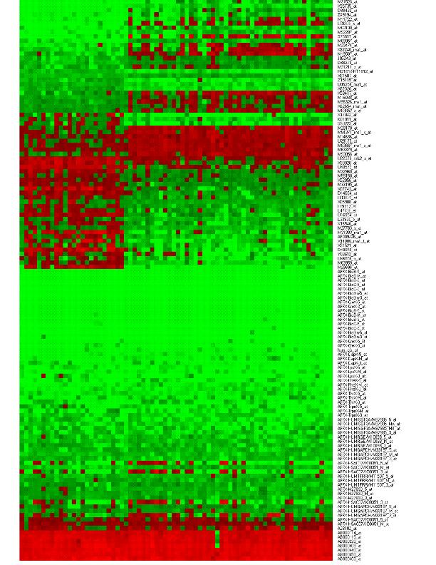
Challenges in microarrays
Data produced by microarrays are exponentially increasing.
Publicly available datasets contain gene expression data with tens of thousands characteristics.
Data are incomplete and noisy.
Current classification methods can over-fit the problem, providing models that do not generalize well.

Slide 15
Linear discriminant planes
Consider a binary classification task with points in two linearly separable sets.
  There exists a plane that classifies all points in the two sets
There are infinitely many planes that correctly classify the training data.
–
–
–
–
–
–
–
–
–
–
–
–
B
–
B
A
–
+
A
–
–
+
+
+
+
+
+
+
+
+
+
+
+
+

Slide 16
Support Vector Machines
Find the plane x’ω-b=0 which maximizes the margin between the two classes
Only few points are needed to compute the plane (support vectors).
||
ω
||
2
–
–
min
–
–
–
–
ω
≠
0
2
–
–
–
–
–
–
–
B
–
+
B
A
–
+
s
.
t
.
A
ω
+
b
≥
e
A
–
–
+
+
+
ω
+
<
−
B
b
e
+
+
+
+
+
+
+
+
+
+
+

Slide 17
SVM classification
The robustness of SVM relies in the strong fundamentals of statistical learning theory.
The training relies on optimization of a quadratic convex cost function, for which many methods are available.
  Available packages for R, Matlab, Weka include SVM-Lite and LIBSVM.
These techniques can be extended to the nonlinear discrimination, embedding the data in a nonlinear space using kernel functions.

Slide 18
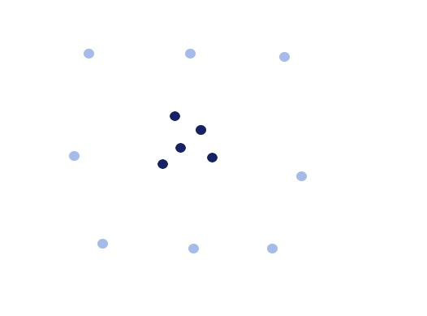
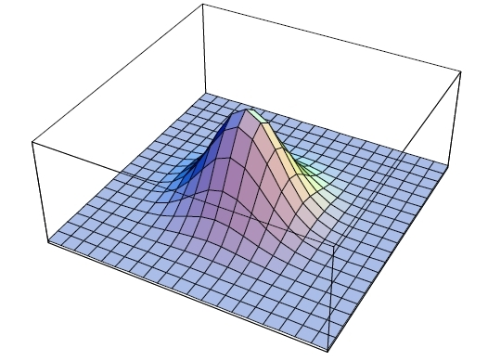
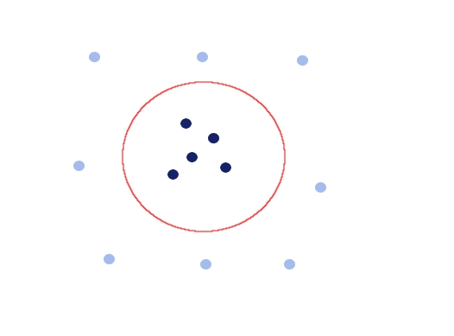
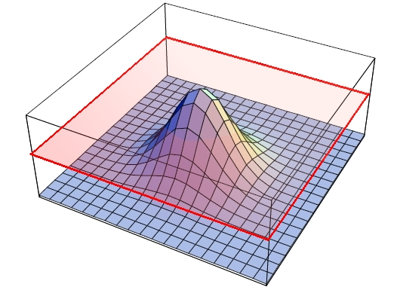
The kernel trick
To obtain greater separability between classes, nonlinearly embed points into a higher dimensional space

Slide 19
Prior knowledge
It is possible to integrate external or prior knowledge in a classification model.
A natural approach is to plug such knowledge in a classifier adding directly more points to the training set.
This results in higher computational complexity, and in a tendency to overfitting.
Different strategies need to be devised to take advantage of prior knowledge.

Slide 20
Prior knowledge
An interesting approach is to analytically express knowledge as additional constraints to the optimization problem defining a standard SVM.
This solution has the advantage
  not to increase the dimension of the training set,
  to avoid overfitting and poor generalization of the classification model.
An analytical expression of knowledge is needed.

Slide 21
Prior knowledge incorporation
−
+
h₁(x) ≤ 0
+
+
+
−
+
−
+
g(x) ≥ 0
+
−
+
−
K(x’, Γ^{T})u = γ
−
−
−
h₂(x) ≤ 0

Slide 22
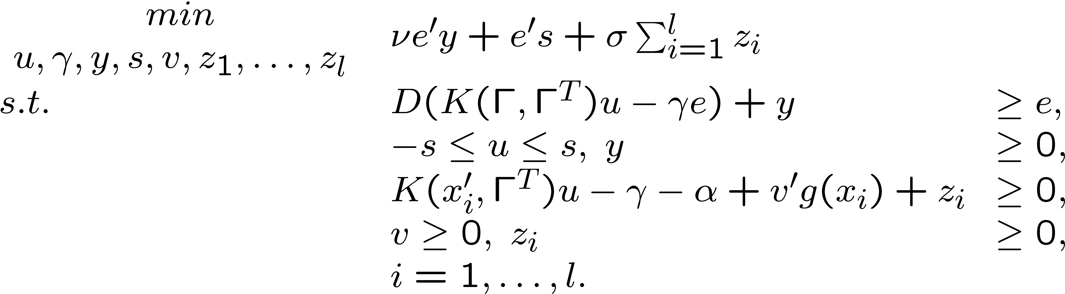
Prior knowledge in SVM
Maximize the margin between the two classes, constraining the classification model to leave one positive region in the corresponding halfspace:
Simple extension to multiple knowledge regions.
O. Mangasarian, E. Wild Nonlinear Knowledge-Based Classification. IEEE TNN, 2008.

Slide 23
A different religion: ReGEC
A binary classification problem can be formulated as a generalized eigenvalue problem (ReGEC).
  Find x’w₁=γ₁ the closer to A and the farther from B:
–
||
A
ω
−
e
γ
||
2
–
–
–
min
–
ω,
γ
≠
0
||
B
ω
−
e
γ
||
2
–
–
–
–
–
–
–
B
–
B
A
–
?
+
A
–
–
+
+
+
+
+
+
+
+
+
+
+
+
+
O. Mangasarian, E. Wild Multisurface Proximal Support Vector Classification via Generalized Eigenvalues. IEEE PAMI 2006.

Slide 24
A different religion: ReGEC
A binary classification problem can be formulated as a generalized eigenvalue problem (ReGEC).
  Find x’w₁=γ₁ the closer to A and the farther from B:
–
||
A
ω
−
e
γ
||
2
–
–
–
min
–
ω,
γ
≠
0
||
B
ω
−
e
γ
||
2
–
–
–
–
–
–
–
B
–
+
B
A
–
?
+
A
–
–
+
+
+
+
+
+
+
+
+
+
+
+
+
O. Mangasarian, E. Wild Multisurface Proximal Support Vector Classification via Generalized Eigenvalues. IEEE PAMI 2006.

Slide 25
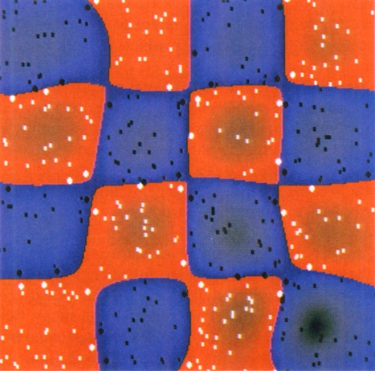
The kernel trick for ReGEC
The nonlinear embedding is obtained with a RBF kernel function:
Each element of kernel matrix is:
||
x
−
x
||
2
−
i
j
K
(
x
,
x
)
=
e
σ
i
j
||
A
−
Γ
||
2
−
i
j
K
(
A
,
Γ
)
=
e
σ
ij

Slide 26
A different religion: ReGEC
The problem can be restated as: find two hyperplanes (in the feature space), each the closest to one set and the furthest from the other.
The binary classification problem can be solved as a generalized eigenvalue problem.
||
K
(
A
,
Γ
)
u
−
e
γ
||
2
–
–
min
–
–
K
(
x
'
,
Γ
)
u
−
γ
=
0
u
,
γ
≠
0
||
K
(
B
,
Γ
)
u
−
e
γ
||
2
–
–
1
1
–
–
–
–
–
–
–
–
–
+
–
–
+
Γ
=
⎡
A
⎤
+
+
+
K
(
x
'
,
Γ
)
u
−
γ
=
0
⎢
B
⎥
2
2
⎣
⎦
+
+
+
+
+
+
+
+
+
+
+

Slide 27
ReGEC
||
K
(
A
,
Γ
)
u
−
e
γ
||
2
||
[
K
(
A
,
Γ
)
−
e
]
T
[
u
′
γ
]
′
||
2
min
=
min
Let
the equation becomes:
Rayleigh quotients of Gz = λHz.
u
,
γ
≠
0
||
K
(
B
,
Γ
)
u
−
e
γ
||
2
u
,
γ
≠
0
||
[
K
(
B
,
Γ
)
−
e
]
T
[
u
′
γ
]
′
||
2
G
=
[
K
(
A
,
Γ
)
−
e
]
T
[
K
(
A
,
Γ
)
−
e
],
H
=
[
K
(
B
,
Γ
)
−
e
]
T
[
K
(
B
,
Γ
)
−
e
],
z
=
[
u
′
γ
]'.
z
′
Gz
min
z
∈
R
n
+
1
z
′
Hz

Slide 28
Regularization of ReGEC
To regularize the problem, generate the two proximal surfaces:
solving
K_{A} and K_{B} main diagonals of K(A, Γ) and K(B, Γ)
K
(
x
'
,
Γ
)
u
1
−
γ
=
0
K
(
x
'
,
Γ
)
u
2
−
γ
=
0
1
2
~
||
K
(
A
,
Γ
)
u
−
e
γ
||
2
+
δ
||
K
u
−
e
γ
||
2
min
A
u
,
γ
≠
0
||
K
(
B
,
Γ
)
u
−
e
γ
||
2
~
||
K
(
B
,
Γ
)
u
−
e
γ
||
2
+
δ
||
K
u
−
e
γ
||
2
min
B
u
,
γ
≠
0
||
K
(
A
,
Γ
)
u
−
e
γ
||
2
~
~
M.R. Guarracino, C. Cifarelli, O. Seref, P. Pardalos. A Classification Method Based on Generalized Eigenvalue Problems, OMS, 2007.

Slide 29
Prior knowledge in ReGEC
It is possible to extend prior knowledge to Regularized Generalized Eigenvalue Classifier (ReGEC).
The new algorithm halves the missclassification error of the original method.
The idea of increasing the information contained in the training set with additional knowledge is appealing for biomedical data.
The experience of field experts or previous results can be readily transferred to new problems.

Slide 30
Prior knowledge in ReGEC
Let Δ be the set of points in B describing a priori knowledge, constraint matrix C represents knowledge imposed on class B :
Constraint imposes all points in Δ to have zero distance from the plane => to belong to B
–
–
–
–
K
(
x
'
,
Γ
)
u
−
γ
=
0
–
–
1
1
–
–
–
–
–
–
–
x
∈
Δ
⇒
C
T
z
=
0
–
–
+
–
–
+
+
+
+
K
(
x
'
,
Γ
)
u
−
γ
=
0
2
2
+
+
+
+
+
+
+
+
+
+
+

Slide 31
Prior knowledge in ReGEC
Prior knowledge can be expressed in terms of orthogonality of the solution to a chosen subspace:
where C is a n × p matrix of rank r, with r < p < n
The constrained eigenvalue problem with prior knowledge for points in class B is:
C
T
z
=
0
z
'
G
z
min
,
z
≠
0
z
'
H
z
s
.
t
.
C
T
z
=
0

Slide 32
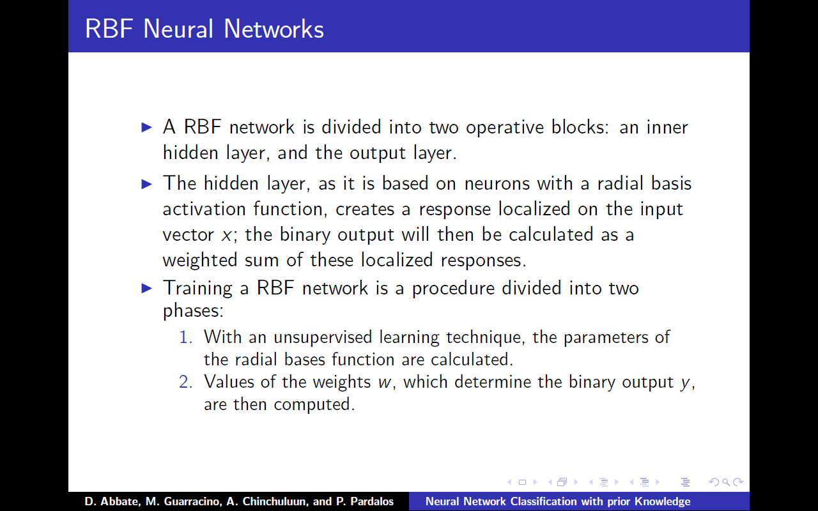
Radial Basis Function Neural Networks

Slide 33
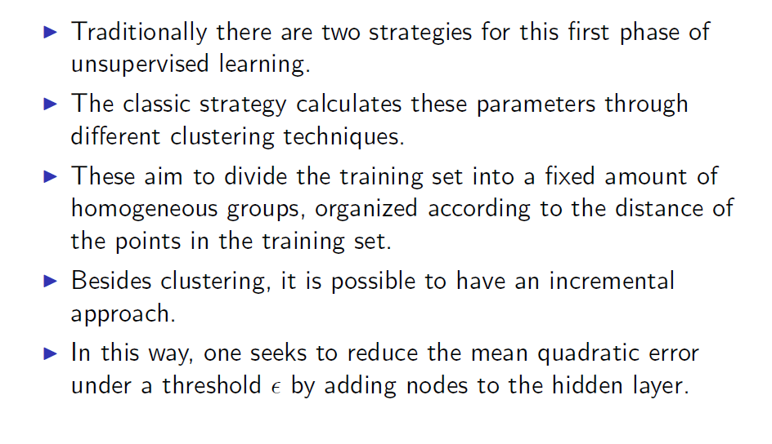
RBF network parameter estimation

Slide 34
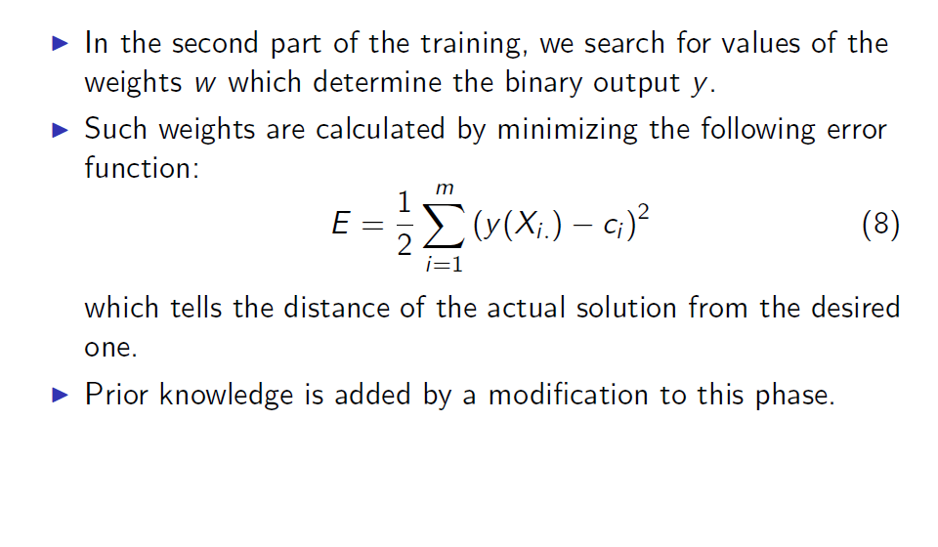
RBF network weights estimation

Slide 35
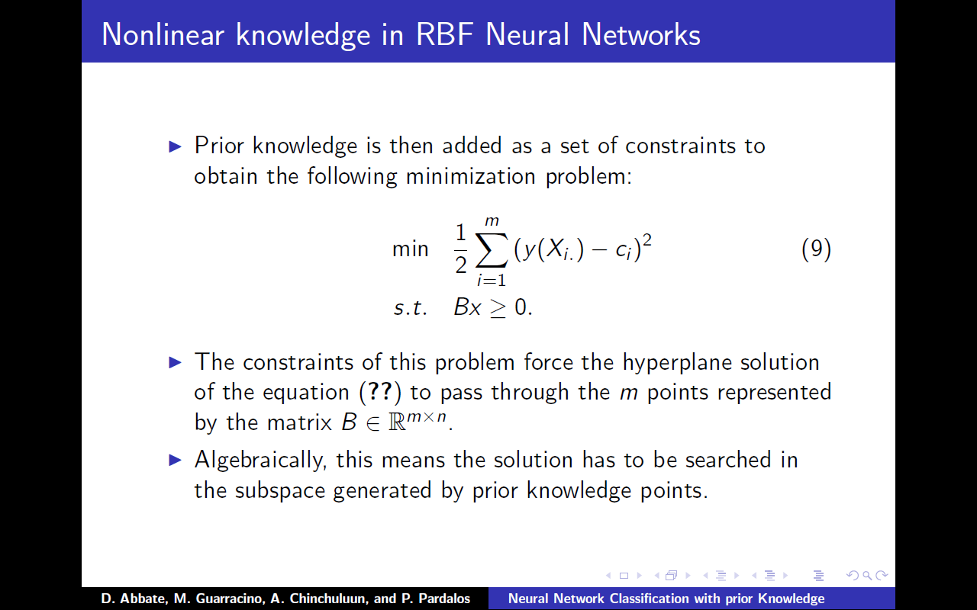
Prior knowledge in RBF NN

Slide 36
Knowledge as a mining task
Is it possible to choose a method to discover knowledge in the training data, using a learning method consistently different from SVM?
Logic mining method Lsquare, combined with a feature selection based on integer programming, has been used to extract logic formulas from the data.
The most meaningful portions of such formulas represent prior knowledge for ReGEC.

Slide 37
Knowledge discovery for ReGEC
Results exhibit an increase in the recognition capability of the system
We propose a combination of two very different learning methods:
  ReGEC, that operates in a multidimensional Euclidean space, with highly nonlinear data transformation, and
  Logic Learning, that operates in a discretized space with models based on propositional logic
The former constitutes the master learning algorithm, while the latter provides the additional knowledge

Slide 38
Logic formulas
The additional knowledge for ReGEC is extracted from training data with a logic mining technique
Such choice is motivated by two main considerations:
  the nature of the method is intrinsically different from the ReGEC adopted as primary classifier;
  the logic formulas are, semantically, the form of ``knowledge" closest to human reasoning and therefore resemble at best contextual information.
The logic mining system consists of two main components, each characterized by the use of integer programming models

Slide 39
Discretization
When the data is in numeric form, the discretization method builds, from each original variable, one or more logic variables based on some thresholds on the range of variation of the variable.
This is accomplished by an iterative procedure that first sections the variation interval of the variable in a large number of intervals, and then joins these intervals based on class entropy.

Slide 40
Feature Selection
The Set Covering Approach for FS (Rutgers - LAD approach)
A binary variable is associated with each feature.
A linear constraint is associated with each pair of objects belonging to different classes.
A set covering model is used requires that each pair of objects belonging to different classes are differentiated by at least one of the selected features.
min
∑
x
a_{(ij)k} = 1 if and only if
Objects i,k belong to different classes
Objects i,k are different on feature j
a_{(ij)k} = 1 feature j selected in the solution
j
j
s
.
t
.
∑
a
x
≥
1
∀
(
i
,
k
)
:
i
∈
A
,
k
∈
I
j
(
ik
)
j
j
x
=
{
0
,
1
}
j

Slide 41
The Lsquare Logic Miner
Builds logic separations in Disjunctive Normal Form (DNF)
Identifies iteratively the clauses of the DNF that separates the largest part of object in one class from all the objects of the other class
Clause identification is based on the solution of a Minimum Cost Satisfiability Problem (MINSAT), computationally hard
q
1
∨
q
2
∨
p
3
∨
p
4
∨
q
4
⎧
1
p
=
True
,
q
=
False
q
1
∨
p
2
∨
p
3
∨
q
4
⎪
i
i
q
∨
p
∨
p
∨
p
s
i
=
⎨
−
1
p
i
=
False
,
q
i
=
True
1
2
3
4
⎪
0
p
=
q
=
False
¬
q
1
∨
d
1
,
¬
q
2
∨
d
1
,
¬
q
3
∨
d
1
,
¬
q
4
∨
d
1
,
¬
p
4
∨
d
1
⎩
i
i
¬
∨
¬
∨
¬
∨
¬
∨
¬
∨
p
1
d
2
,
p
2
d
2
,
q
2
d
2
,
p
3
d
1
,
q
4
d
1
Satisfying solution:
P. Bertolazzi, G. Felici, P. Festa, G. Lancia. Logic classification and feature selection for biomedical data, Computer and Mathematics, 2008.

Slide 42
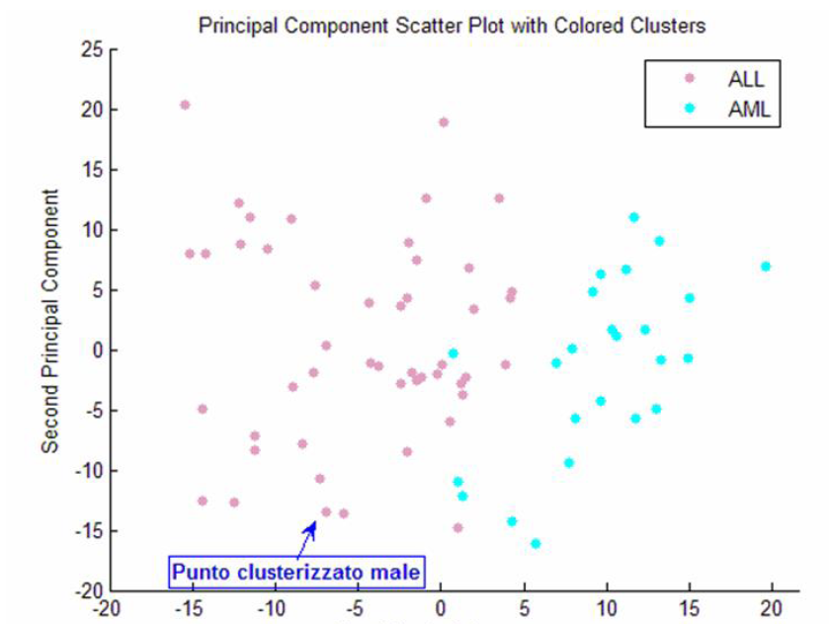
Acute Leukemia data
Golub microarray dataset (Science, 1999)
The microarray data have 72 samples with 7129 gene expression values
Data contain 25 Acute Myeloid Leukemia and 47 Acute Lymphoblastic Leukemia samples

Slide 43
Logic formulas
The dataset has been discretized and the logic formulas have been evaluated. Those formulas are in the form:
    IF p(4196) > 3.435 AND p(6041) > 3.004 THEN class1,
    IF p(6573) < 2.059 AND p(6685) > 2.794 THEN class1,
    IF p(1144) > 2.385 AND p(4373) < 3.190 THEN class − 1,
    IF p(4847) < 3.006 AND p(6376) < 2.492 THEN class − 1,
where p(i) represents the i-th probe.
The knowledge region for each class, are those given by the intersection of all chosen formulas.

Slide 44
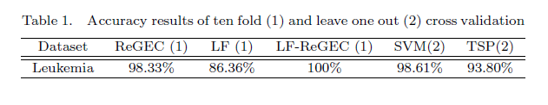
Classification accuracy
Leave one out cross validation used for ReGEC.
The ReGEC method with prior knowledge found with LF becomes fully accurate on the dataset.

Slide 45
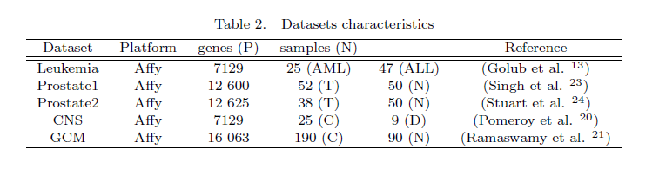
Microarray experiments
Results regard its performance in terms of classification accuracy.

Slide 46
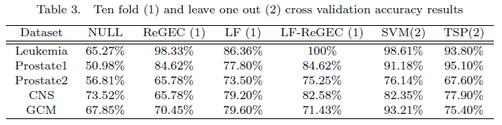
Accuracy results
LF method is more accurate than TSP in three cases out of five.
In all cases, LF-ReGEC, produces equal or higher accuracy results.

Slide 47
Conclusion
Microarrays experiments produce challenging datasets.
Available classification methods provide results affected by noisy and incomplete data.
RNA-seq whole genome sequencing facilities will shortly provide even harder problems.
Omics sciences are an infinite source of problems in which decisions are based on incomplete and uncertain data.

